Slide 1
Capturing Semantics for Imputation with Pre-trained Language Models
Yinan Mei¹, Shaoxu Song¹, Chenguang Fang¹, Haifeng Yang², Jingyun Fang ², Jiang Long ²
¹BNRist, Tsinghua University, China
² Data Governance Innovation Lab, HUAWEI Cloud BU, China
ICDE 2021

Slide 2
Outline
Background
Motivation
Overview
Proposal: IPM-Multi
Proposal: IPM-Binary
Experiments
ICDE 2021

Slide 3
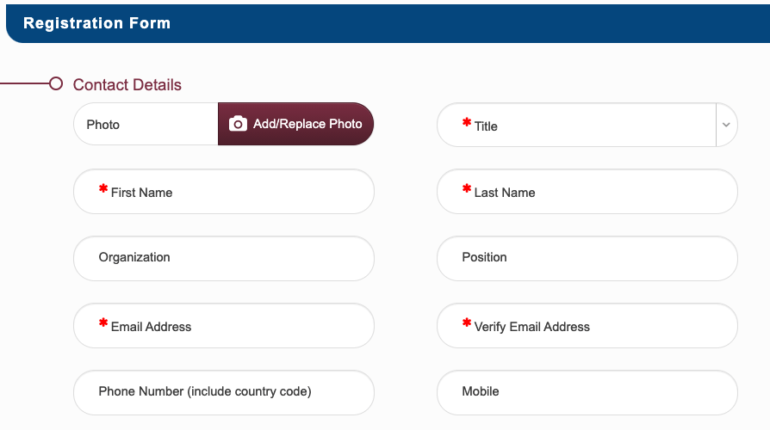
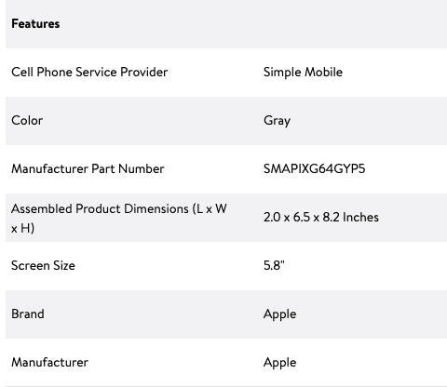
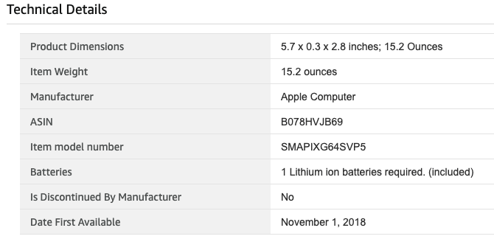
1. Background: Missing Data
Missing data are prevalent
Optional inputs in the information collection systems
Different schemas in integrating heterogenous data sources
ICDE 2021
Notes:
In practice, missing data are prevalent for many reasons such as
the optional inputs in the information collection system
and different schemas in integrating heterogenous data sources, and so on.
Obviously, these missing values signiﬁcantly reduce the quality of the data and make the data hard to use.
It‘s highly demanded to impute these missing values.

Slide 4
2. Motivation
Many existing imputation techniques depend on the symbolic similarity metrics
String edit distance, term jaccard similarity
However, relying solely on symbolic similarity does not always lead to accurate results
k-NN (k=3) with term jaccard similarity
r | title | category | modelno | price
t1 | tribeca varsity jacket hard shell case for ipod touch dallas cowboys | NaN (mp3 accessories) | fva3778 | 18.54
t2 | oklahoma sooners iphone 4 case black shell | electronics general | fva3161 | 29.99
t3 | belkin sport armband for ipod nano black | mp3 accessories | f8z514tt064 | 18.88
t4 | case logic 11.6 hard shell netbook sleeve | electronics general | 154722 | 19.99
t5 | fellowes hd precision cordless mouse | mice | 98904 | 44.84
... | ... | ... | ... | ...
r | title | category | modelno | price
t1 | tribeca varsity jacket hard shell case for ipod touch dallas cowboys | NaN (mp3 accessories) | fva3778 | 18.54
t2 | oklahoma sooners iphone 4 case black shell | electronics general | fva3161 | 29.99
t3 | belkin sport armband for ipod nano black | mp3 accessories | f8z514tt064 | 18.88
t4 | case logic 11.6 hard shell netbook sleeve | electronics general | 154722 | 19.99
t5 | fellowes hd precision cordless mouse | mice | 98904 | 44.84
... | ... | ... | ... | ...
ICDE 2021
Notes:
Many existing imputation techniques depend on the symbolic similarity metrics, such as string edit distance and term jaccard similarity.
However, relying solely on symbolic similarity does not always lead to accurate results.
Consider a part of the real product dataset Walmart.
Tuple t1-t5 represent five different products with four attributes.
There is a missing entry t1[category].
The nearest neighbor based imputation, such as kNN, ﬁnds top-k tuples that are most similar to t1 on the complete attributes.
The major class of the k neighbors on the to-impute attribute “category” will be taken as the imputation for t1[category ].
For example, given k as 3 and term jaccard similarity as the similarity metric, kNN will identify t2 , t3 , t4 as neighbors.
And “electronics general”, the major class on the attribute “category” of the 3-NNs, will be imputed in t1 [category ].
It is wrong given the truth “mp3 accessories”.

Slide 5
2. Motivation
Some imputation techniques [1] inferring corrections from co-occurring attribute values
suffer the sparsity problem.
co-occurrence w.r.t values are not always available
r | title | category | modelno | price
t1 | tribeca varsity jacket hard shell case for ipod touch dallas cowboys | NaN (mp3 accessories) | fva3778 | 18.54
t2 | oklahoma sooners iphone 4 case black shell | electronics general | fva3161 | 29.99
t3 | belkin sport armband for ipod nano black | mp3 accessories | f8z514tt064 | 18.88
t4 | case logic 11.6 hard shell netbook sleeve | electronics general | 154722 | 19.99
t5 | fellowes hd precision cordless mouse | mice | 98904 | 44.84
... | ... | ... | ... | ...
r | title | category | modelno | price
t1 | tribeca varsity jacket hard shell case for ipod touch dallas cowboys | NaN (mp3 accessories) | fva3778 | 18.54
t2 | oklahoma sooners iphone 4 case black shell | electronics general | fva3161 | 29.99
t3 | belkin sport armband for ipod nano black | mp3 accessories | f8z514tt064 | 18.88
t4 | case logic 11.6 hard shell netbook sleeve | electronics general | 154722 | 19.99
t5 | fellowes hd precision cordless mouse | mice | 98904 | 44.84
... | ... | ... | ... | ...
[1] T. Rekatsinas, X. Chu, I. F. Ilyas, and C. R´e. Holoclean: Holistic data repairs with probabilistic inference. Proc. VLDB Endow., 10(11):11901201, 2017.
ICDE 2021
Notes:
Some imputation techniques such as HoloClean inferring corrections from co-occurring attribute values suffer the sparsity problem.
The co-occurrence with respect to values are not always available, as shown in the table.
There is no tuple sharing the same attribute value with t1 and thus these methods cannot apply.

Slide 6
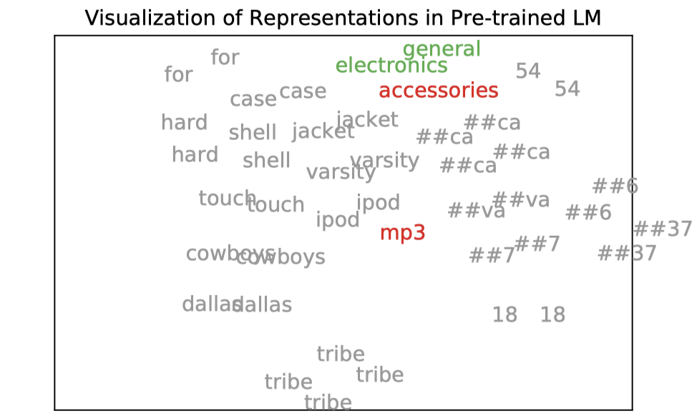
2. Motivation
co-occurrences w.r.t. tokens are widely existed
External knowledge (Corpus for pre-training)
To-impute data (Model fine-tuning)
Impute the missing values by further considering semantics w.r.t the ﬁne-grained tokens.
r | title | category | modelno | price
t1 | tribeca varsity jacket hard shell case for ipod touch dallas cowboys | NaN (mp3 accessories) | … | 18.54
t2 | oklahoma sooners iphone 4 case black shell | electronics general | … | 29.99
t3 | belkin sport armband for ipod nano black | mp3 accessories | … | 18.88
... | ... | ... | ... | ...
ICDE 2021
Notes:
However, co-occurrences are widely existed in the external knowledge and to-impute data.
We can use the pre-trained model to obtain the external co-occurrence relationship.
And we can also fine-tuned the pre-trained model on to-impute data to capture the data-specific co-occurrence relationship.
Thus, we propose to impute the missing values by further considering semantics with respect to the ﬁne-grained tokens.
As we can see from the bottom figure, we visualize the token representations obtained by the pre-trained language model.
These tokens are from t1 and its two candidate filling “mp three accessories” and “electronics general” for the missing entry.
We can find the tokens “ipod” and “touch” in red are more semantically related to token “mpthree” in grey than “electronics general” in green.
Therefore, if we consider semantics for imputation, the missing entry will be correctly imputed.

Slide 7
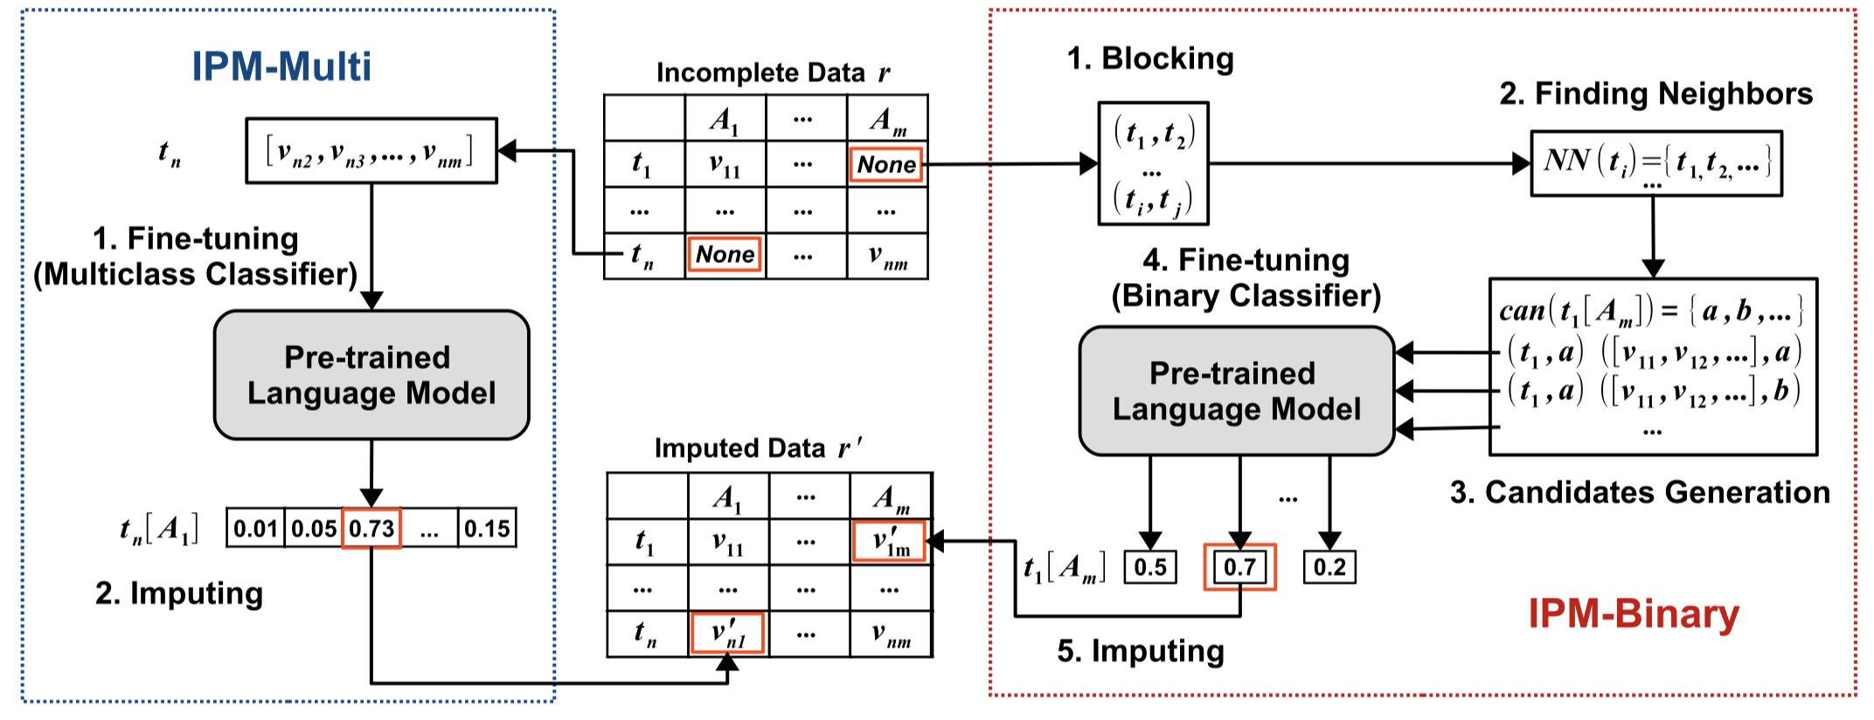
3. Overview
IPM consists of two alternatives:
IPM-Multi:
Multiclass classification; direct solution
IPM-Binary:
Binary classification; require less training data
ICDE 2021
Notes:
To impute missing values with semantics, we propose an imputation method based on the pre-trained language model, IPM.
As shown in this figure, IPM consists of two alternatives named IPM-Multi and IPM-Binary.
IPM-Multi consider the imputation task as a multi-class classification problem,
While IPM-Binary takes it as a binary classification problem.
When we have sufﬁcient training data, IPM-Multi can achieve good performance. Otherwise, IPM-Binary is a better choice.

Slide 8
4. Proposal: IPM-Multi
Imputation <-> Multiclass classification
$\#Class = |dom(A)|$
Step 1: Fine-tuning in IPM-Multi
Unsupervised -> Masked entry recovery
Step 2: Imputing in IPM-Multi
[belkin, …, ipod, ..., 18.88]
[tribeca, …, ipod, ..., 18.54]
r | title | category | modelno | price
t3 | belkin… ipod .. | [MASK] (mp3 accessories) | … | 18.88
... | ... | ... | ... | ...
r | title | category | modelno | price
t1 | tribeca … ipod … | NaN | … | 18.54
… | … | … | … | …
Pre-trained
Language Model
Fine-tuned
Pre-trained
Language Model
0.01 | 0.21 | 0.65 | …
0.01 | 0.11 | 0.82 | …
mice
electronic general
mp3 accessories
mice
electronic general
mp3 accessories
ICDE 2021
Notes:
IPM-Multi consider imputation as a multiclass classification problem.
For each attribute, we fine-tune the pre-trained language model as a multiclass classifier, where the number of class is the domain size of the attribute.
To impute the missing entry, we need to fine-tune the model first.
To avoid introducing high labeling cost, we mask some complete entries and try to train the model to recover them.
For example, we mask the category attribute in t3 whose original value is mp3 accessories.
Then we input the other complete attribute values into the pre-trained model and predict which class the masked entry belongs to.
The pre-trained model and the classifier are then optimized jointly.
When we have the fine-tuned model, we use it to predict the class of the real missing value. The class with the highest probability will be taken as the imputation result.

Slide 9
4. Proposal: IPM-Multi
Model Architecture
r | title | category | modelno | price
t3 | belkin sport armband for ipod nano black | [MASK] | … | 18.88
mice
electronic general
mp3 accessories
0.01 | 0.21 | 0.65 | …
Multiclass Classifier
Contextualized
Embeddings
$$E_{[CLS]}^{c}$$
$$E_{belkin}^{c}$$
$$E_{sport}^{c}$$
…
$$E_{18.88}^{c}$$
$$E_{[SEP]}^{c}$$
Transformer Layer
Transformer Layer
Embeddings
$$E_{[CLS]}$$
$$E_{belkin}$$
$$E_{sport}$$
…
$$E_{18.88}$$
$$E_{[SEP]}$$
[CLS]
belkin
sport
…
18.88
[SEP]
ICDE 2021
Notes:
The flow can be summarized into three steps.
First, we need to serialize the values of complete attributes into a sequence of tokens, where [CLS] and [SEP] are special tokens that represent the start and the end of the sequence, respectively.
The pre-trained language model transforms tokens into embeddings.
Then, the stacked transformer layers capture the hidden semantics between tokens and output the contextualized embeddings for each token.
Third, a multiclass classiﬁer takes the contextualized embedding of CLS as the input and outputs the probability that each value in the domain is the correct filling for the missing cell.

Slide 10
4. Proposal: IPM-Multi
Low Redundancy
Large Domain Size
Limited Training Data
Over-fitting
Dataset | # Tuples | # Domain Size (# Class)
Flipkart | 8884 | 3453
# Avg samples
8884/3453=2.57
3453
0.01 | … | … | …
Multiclass Classifier
Contextualized
Embeddings
$$E_{[CLS]}^{c}$$
$$E_{…}^{c}$$
$$E_{…}^{c}$$
…
$$E_{…}^{c}$$
$$E_{[SEP]}^{c}$$
Transformer Layer
Transformer Layer
Embeddings
$$E_{[CLS]}$$
$$E_{...}$$
$$E_{….}$$
…
$$E_{…}$$
$$E_{[SEP]}$$
[CLS]
…
…
…
…
[SEP]
ICDE 2021
Notes:
Owing to the low redundancy of databases and large domain sizes, training data are not always sufﬁcient.
For example, the domain size of the “brand” attribute in Flipkart dataset is three thousand four hundred and fifty threee .
However, there are only eight thousand eight hundred and eighty four tuples in Flipkart dataset.
It means that only about 2 tuples are corresponding to each class.
Obviously, this is not enough to train an accurate multiclass classiﬁer for IPM-Multi.
In this case, IPM-Multi will fall into the overfitting problem.

Slide 11
5. Proposal: IPM-Binary
Imputation <-> Binary classification
Generate candidates -> Identify correct filling
Step 1: Candidates Generation in IPM-Binary
r | title | category | modelno | price
t1 | tribeca varsity jacket hard shell case for ipod touch dallas cowboys | NaN (mp3 accessories $\text{electronics} \text{general}$) | … | 18.54
t2 | oklahoma sooners iphone 4 case black shell | electronics general | … | 29.99
t3 | belkin sport armband for ipod nano black | mp3 accessories | … | 18.88
t4 | case logic 11.6 hard shell netbook sleeve | electronics general | … | 19.99
$$NN\left(t_{1}\right)=\{t_{2},t_{3},t_{4}\}$$
can$\left(t_{1}[A_{category}]\right)=\left\{t_{j}\left[A_{category}\right]\left|t_{j}∈NN\left(t_{j}\right)\right|\right\}$
$$=\{“\text{electronics} \text{general}”, “\text{mp}\text{3 }\text{accessories}”\}$$
ICDE 2021
Notes:
For this reason, we propose IPM-Binary that takes the imputation task as a binary classification problem.
To reduce the decision space, we first generate candidates for the model.
And the model is learned to identify which candidate is correct.
So, in IPM-Binary the first step is candidates generation.
For example, as shown in the table, we identify the tuples that share at least one token with t1 as the neighbors of t1.
In this example, the neighbors of t1 are t2,t3 and t4.
And the candidates for the missing cell t1[category] are the category values from the neighbors of t1.
The candidates of t1[category] are electronics general and mp3 accessories marked in blue.

Slide 12
5. Proposal: IPM-Binary
Step 2. Fine-tuning in IPM-Binary (Model Architecture)
0.75
Probability of being correct
Binary Classifier
$$E_{[CLS]}^{c}$$
$$E_{belkin}^{c}$$
$$E_{…}^{c}$$
…
$$E_{mp3}^{c}$$
$$E_{…}^{c}$$
$$E_{[SEP]}^{c}$$
Transformer Layer
Transformer Layer
$$E_{[CLS]}$$
$$E_{belkin}$$
$$E_{sport}$$
…
$$E_{mp3}$$
$$E_{…}$$
$$E_{[SEP]}$$
[CLS]
belkin
…
[SEP]
mp3
…
[SEP]
r | title | category | modelno | price
t3 | belkin sport armband for ipod nano black | mp3 accessories | … | 18.88
Complete Attribute Values
Candidate Filling
ICDE 2021
Notes:
Before we use the model to determine the imputation result, we need to learn the model first.
Thus, the second step is fine-tuning the pre-trained language model.
Unlike IPM-Multi, IPM-Binary takes the combination of complete attribute values as the ﬁrst “sentence”
and the candidate ﬁlling for the incomplete attribute as the second “sentence”.
As illustrated in Figure, a binary classiﬁer is built by taking the contextualized embedding of CLS as the input.
The binary classifier is used to decide whether the candidate value is the correct filling or not.
The parameters of the binary classifier and the pre-trained language model will be updated together during ﬁne-tuning.

Slide 13
5. Proposal: IPM-Binary
Step 2. Fine-tuning in IPM-Binary (Build Training Corpus)
Unsupervised -> Masked entry recovery
Positive Sample: $\{(\text{bel}\text{kin} …\text{ipod} \text{…} \text{18.88}, mp3 accessories, 1)\}$
Negative Samples:
$\left\{\left(\text{bel}\text{kin} …\text{ipod} \text{…} \text{18.88}, v_{n}, 0\right)\right\}, v_{n}≠mp3 accessories$
Negative sampling from candidates
$\left\{\left(\text{bel}\text{kin} …\text{ipod} \text{…} \text{18.88}, v_{n}, 0\right)\right\}, v_{n}≠mp3 .., v_{n}∈can(t_{3}[A_{cat}])$
r | title | category | modelno | price
t2 | oklahoma sooners iphone 4 case black shell | electronics general | … | 29.99
t3 | belkin sport armband for ipod nano black | [MASK] (mp3 accessories) | … | 18.88
… | … | … | … | …
t5 | fellowes hd precision cordless mouse | mice | 98904 | 44.84
r | title | category | modelno | price
t2 | oklahoma sooners iphone 4 case black shell | electronics general | … | 29.99
t3 | belkin sport armband for ipod nano black | [MASK] (mp3 accessories) | … | 18.88
… | … | … | … | …
t5 | fellowes hd precision cordless mouse | mice | 98904 | 44.84
ICDE 2021
Notes:
To fine-tune the model, we have to build the training corpus first.
Similar to IPM-Multi, we also fine-tune the model on the masked entry recovery task.
Obviously, the positive example is the combination of the complete attribute values and the original value of the masked cell.
Intuitively, all values not equal to the original value can be considered as the negative samples such as electronics general and mice in blue.
However, most of tuples that have different attribute values are far different from the missing tuple.
Thus, the learning task is too trival.
For this reason, we propose to conduct negative sampling from candidates.
Then, only the value electronics general as the hard negative samples is used for training.

Slide 14
6. IPM-Binary
3. Imputing in IPM-Binary
Select the candidate with the highest probability
Candidates
mp3 accessories
electronics general
r | title | category | modelno | price
t1 | tribeca … ipod … | NaN (mp3 accessories) | … | 18.54
… | … | … | … | …
t3 | belkin… ipod .. | mp3 accessories | … | 18.88
... | ... | ... | ... | ...
[tribeca, …, ipod, ..., mp3 accessories]
[tribeca, …, ipod, ..., electronics general]
Fine-tuned Pre-trained
Language Model
0.9
0.4
mp3 accessories
ICDE 2021
Notes:
IPM-Binary selects the candidate with the highest probability as the imputation result.
Continuing the example, we have two candidates mp3 accessories and electronics general.
Then we combine the two candidates with the complete attributes respectively.
These two sequences are inputted into the fine-tuned model.
And the model outputs their probability as the imputation.
Finally, we select mp3 accessories with the higher score to impute the missing cell.

Slide 15
7. Experiments
Dataset
Comparison methods
Dataset | Restaurant | Walmart | Amazon | Buy | Housing | Phone | Zomato | Flipkart
#Tuples | 864 | 2300 | 13797 | 651 | 5000 | 4312 | 50279 | 8884
# Avg Class | 49 | 251 | 939 | 62 | 966 | 335 | 93 | 3453
Category | Name
Neighbor | kNNE, MIBOS
Clustering | CMI
Statistical Model | ERACER, DLM, HoloClean
Generative Model | MIDAS, MIWAE, HI-VAE, DataWig
Error Correction | Baran
ICDE 2021
Notes:
We conduct experiments on eight datasets and compare eleven baselines from different categories.

Slide 16
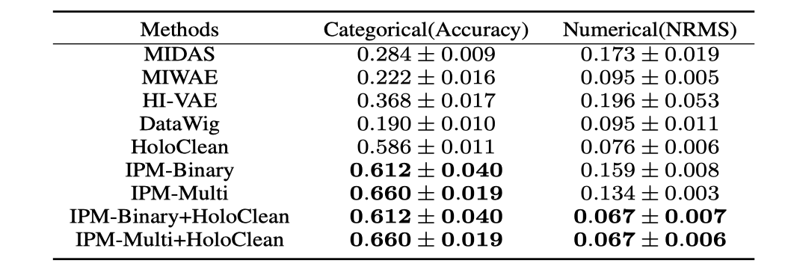
7. Experiments
Comparison with Existing Approaches
ICDE 2021
Notes:
The comparison results show the superiority of our proposed IPM.

Slide 17
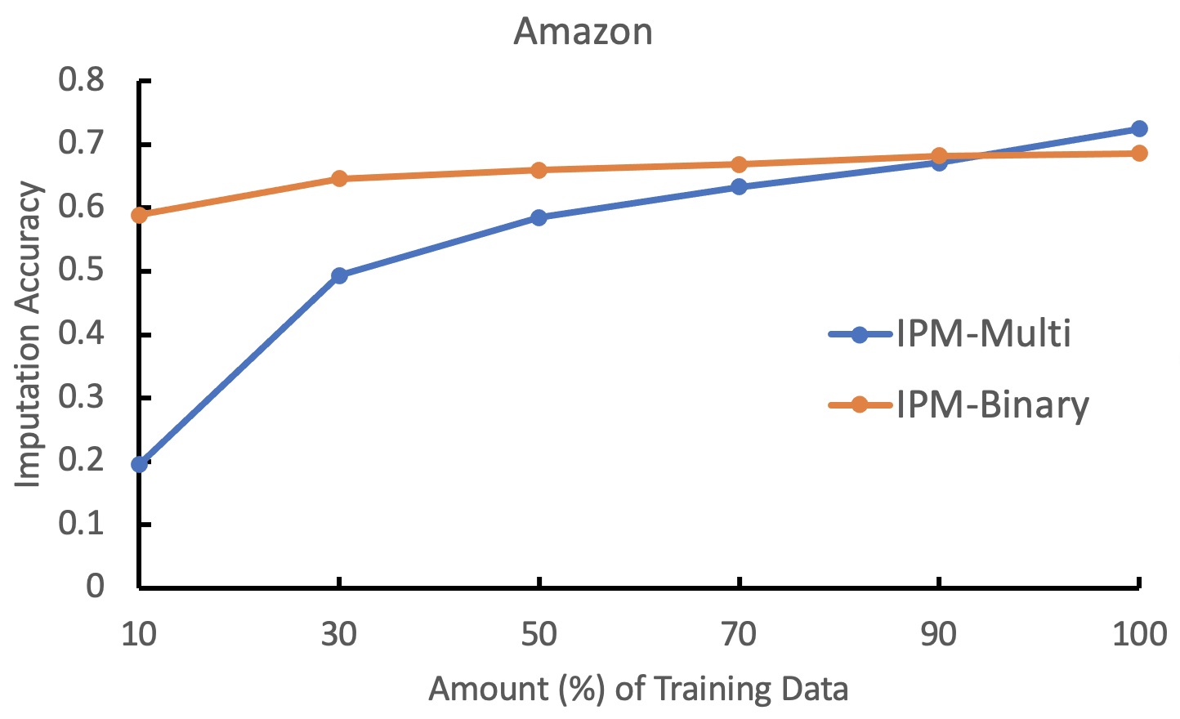
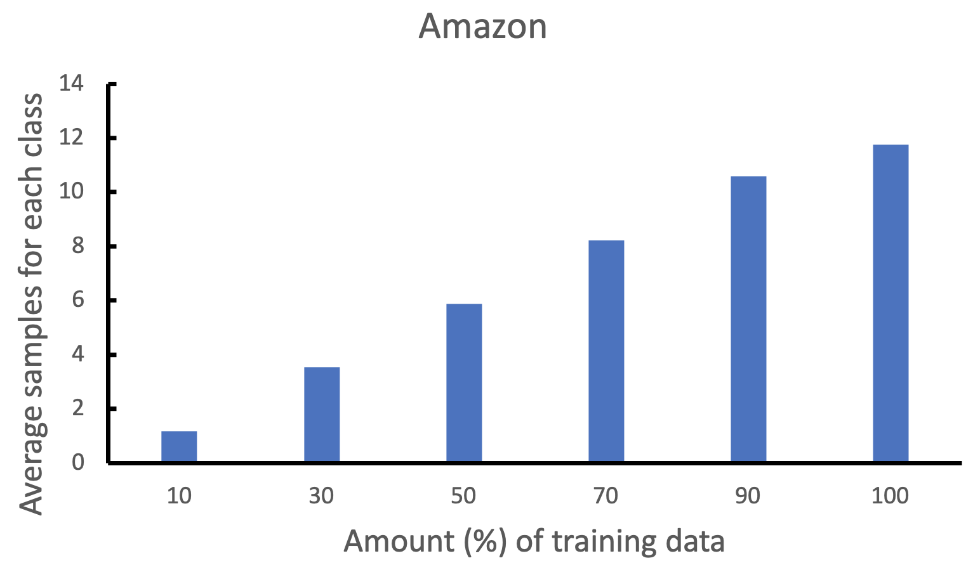
7. Experiments
Varying Amount of Training Data
Empirically, IPM-Multi may have better performance than IPM-Binary, if $\frac{Data Size}{Domain Size}>10$.
ICDE 2021
Notes:
As shown in the figure, IPM-binary requires less training data than IPM-Multi.
But, empirically, if there exist more than 10 training samples for each class, IPM-Multi may have better performance than IPM-Binary.

Slide 18
Q & A
ICDE 2021

