Slide 1

Effective and Efficient Retrieval of Structured Entities
Ruihong Huang¹, Shaoxu Song¹, Yunsu Lee², Jungho Park²,
Soo-Hyung Kim², Sungmin Yi²
¹Tsinghua University
²Samsung Research

Slide 2
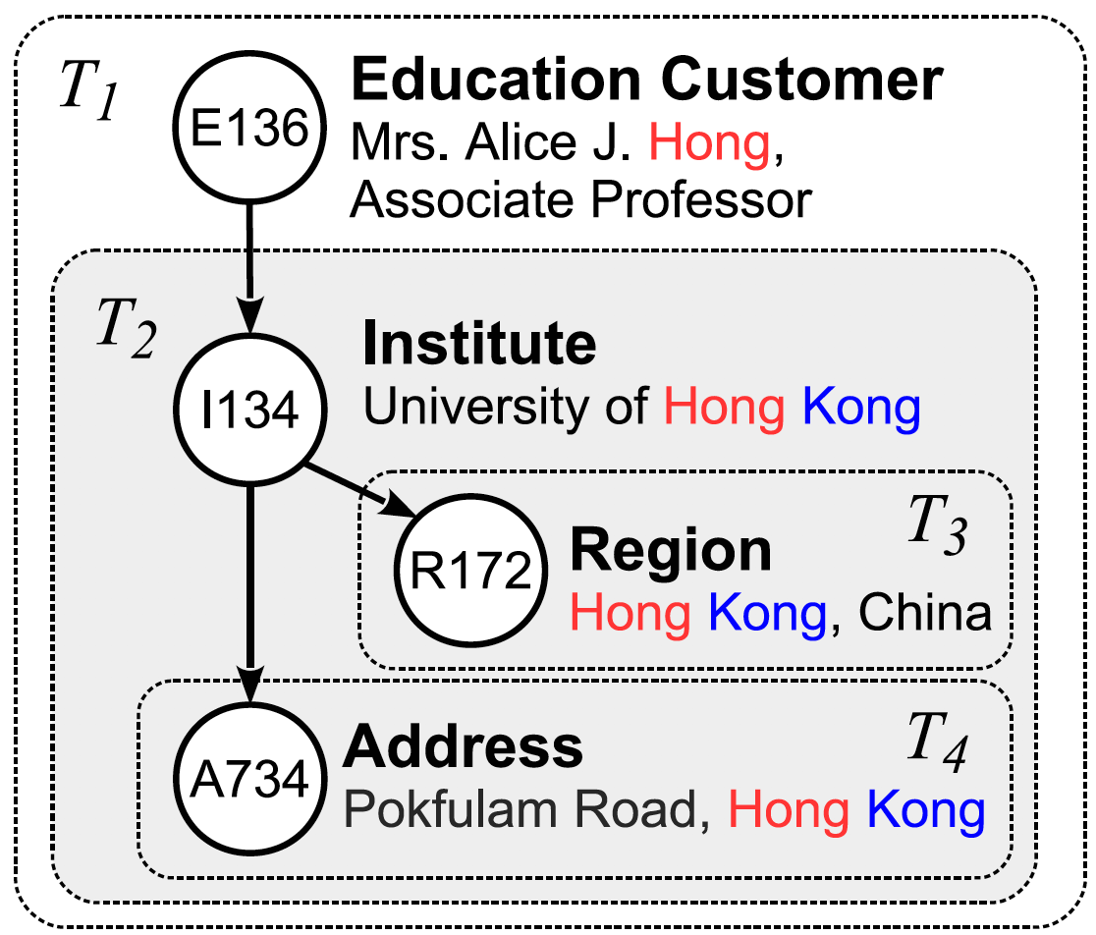
1. Background: Structured Entities
A structured entity is a set of connected nodes
  often in tree structure
  labeled with types and contents
Node | Type | Content
E136 | Education Customer | Mrs. Alice J. Hong, Associate Professor
I134 | Institute | University of Hong Kong
R172 | Region | Hong Kong, China
A734 | Address | Pokfulam Road, Hong Kong

Slide 3
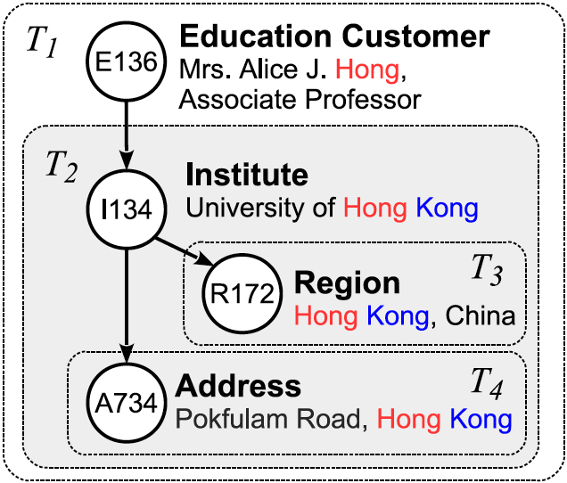
1. Background: Structured Entities
Structured entities are commonly abstracted from various source types.
  In relational database
    tuples connected via primary-foreign keys

Slide 4
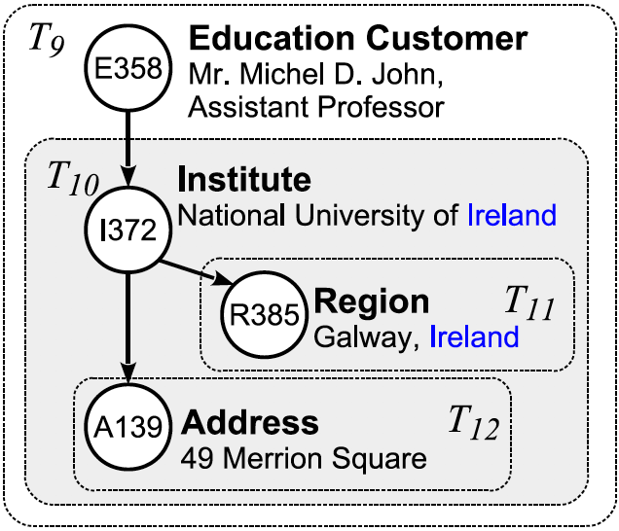
1. Background: Structured Entities
Structured entities are commonly abstracted from various source types.
  In XML
    naturally organized in a tree structure

Slide 5
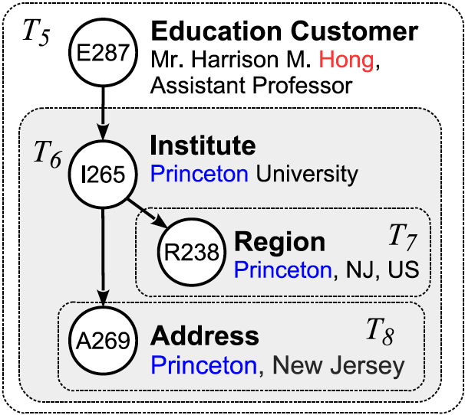
1. Background: Structured Entities
Structured entities are commonly abstracted from various source types.
  In RDF
    entities could be interpreted as subgraphs

Slide 6


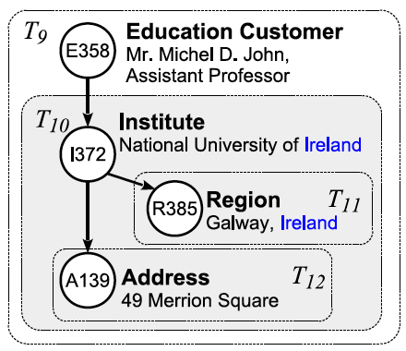
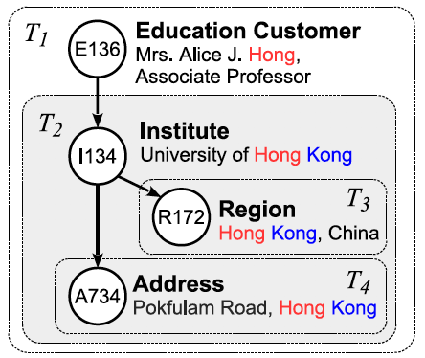
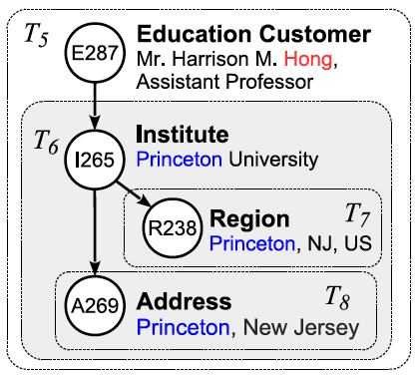
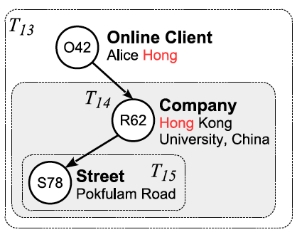
1. Background: Retrieval Problem
Find the structured entities that are most relevant to the query
  denoting the same real-world objects
query

Slide 7
2. Challenges
Overlapping contents
  one structured entity may contain another
  the term Hong appears both in the Education Customer of T1 and the Institute of T2
Overlapping Contents
Parent-Child Relationship

Slide 8
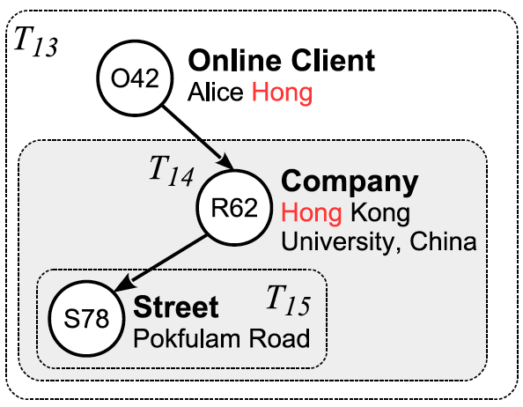
2. Challenges
Structural inconsistency
  T1 and T3 have very distinct structures, but indeed denote the same person in real-world

Slide 9

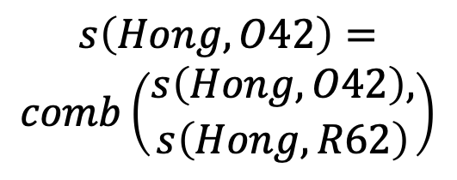

3. Structured Entity Retrieval
Term score
  Node score
    could be evaluated by any IR score function
  Entity score
    combine the scores of nodes in the entity
$$s\left(Hong, O42\right)=1$$
$$s\left(Hong, O42\right)=$$
$$comb\left(\begin{aligned}s\left(Hong, O42\right), \\ s\left(Hong, R62\right)\end{aligned}\right)$$

Slide 10
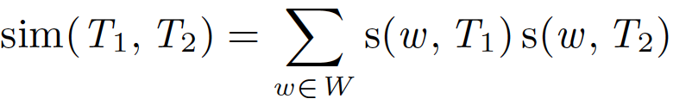
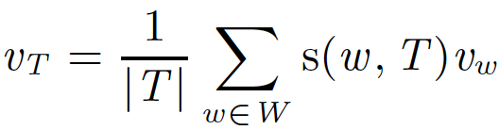
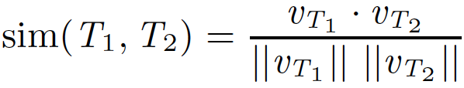
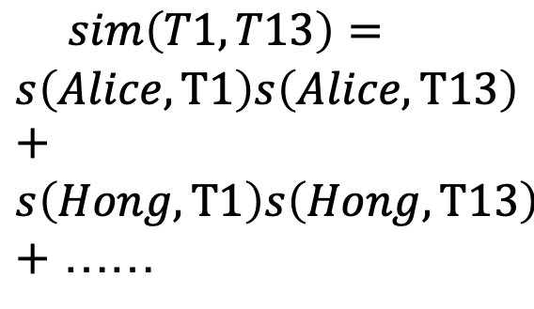
3. Structured Entity Retrieval
Entity similarity
  Term vector similarity
  Embedding vector similarity
$$sim\left(T1, T13\right)=$$
$$s\left(Alice, T1\right)s\left(Alice, T13\right)+$$
$$s\left(Hong, T1\right)s\left(Hong, T13\right)$$
$+$ ……

Slide 11
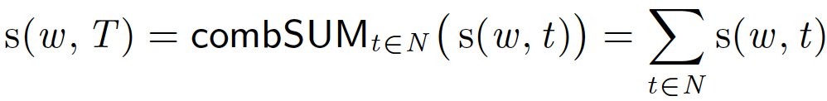
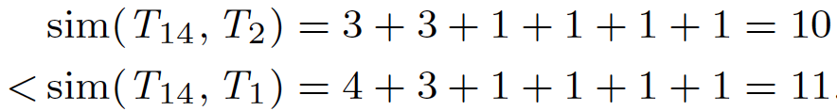
4. Simple Combinations
Score combination by Sum
 | Hong | Kong | University | China | Rokfulam | Road
T₁ | 4 | 3 | 1 | 1 | 1 | 1
T₂ | 3 | 3 | 1 | 1 | 1 | 1
T₁₄ | 1 | 1 | 1 | 1 | 1 | 1

Slide 12
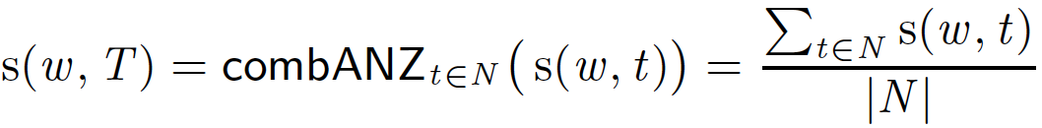
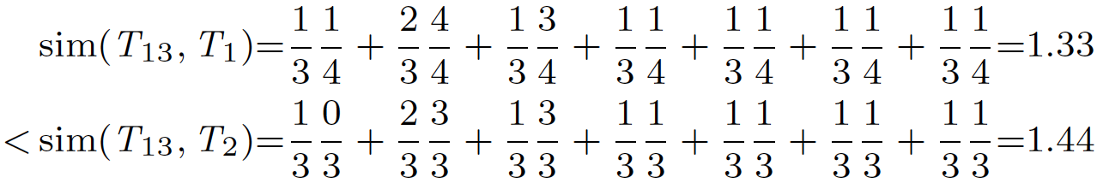
4. Simple Combinations
Score combination by Size Normalization
 | Alice | Hong | Kong | University | China | Rokfulam | Road
T₁ | 1/4 | 4/4 | 3/4 | 1/4 | 1/4 | 1/4 | 1/4
T₂ | 0 | 3/3 | 3/3 | 1/3 | 1/3 | 1/3 | 1/3
T₁₃ | 1/3 | 2/3 | 1/3 | 1/3 | 1/3 | 1/3 | 1/3

Slide 13
5. Structure-aware Combination
Entity family
  a set of entities sharing the same structure w.r.t. node types
    For evaluating how large a type of nodes shares with their children
    For efficient pruning

Slide 14
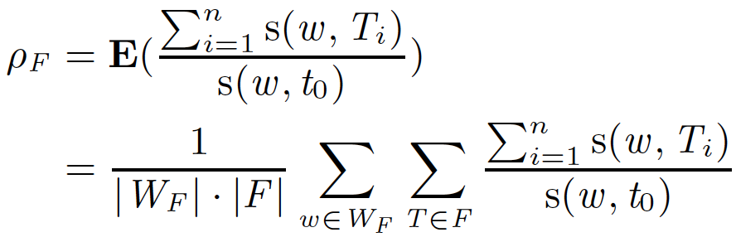
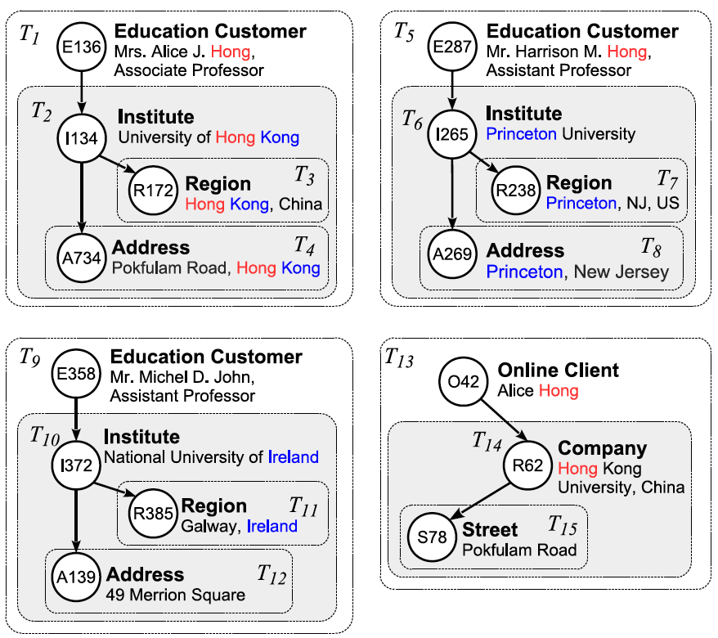
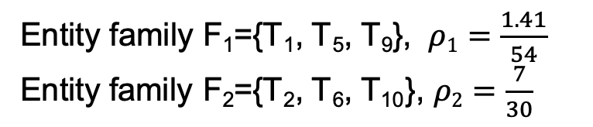
5. Structure-aware Combination
Hierarchy Smooth Combination
Entity family F₁={T₁, T₅, T₉}, $ρ1=\frac{1.41}{54}$
$\text{Entity} \text{family}$ F₂={T₂, T₆, T₁₀}, $ρ2=\frac{7}{30}$

Slide 15
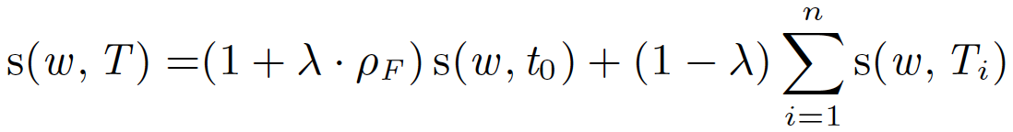
5. Structure-aware Combination
Score by Structure-aware Combination
 | Alice | Hong | Kong | University | China | Rokfulam | Road
T₁ | 1.02 | 1.16 | 0.141 | 0.121 | 0.01 | 0.01 | 0.01
T₂ | 0 | 1.41 | 1.41 | 1.21 | 0.1 | 0.1 | 0.1
T₁₃ | 1.9 | 2.09 | 0.19 | 0.19 | 0.19 | 0.01 | 0.01
T₁₄ | 0 | 1.9 | 1.9 | 1.9 | 1.9 | 0.1 | 0.1
$sim\left(T_{13},T_{1}\right)=4.43>sim\left(T_{13},T_{2}\right)=3.47$, ${ T}_{13} matches T_{1}$
$$sim\left(T_{14},T_{1}\right)=2.73<sim\left(T_{14},T_{2}\right)=7.87\text{, }{ T}_{14} matches T_{2}$$

Slide 16
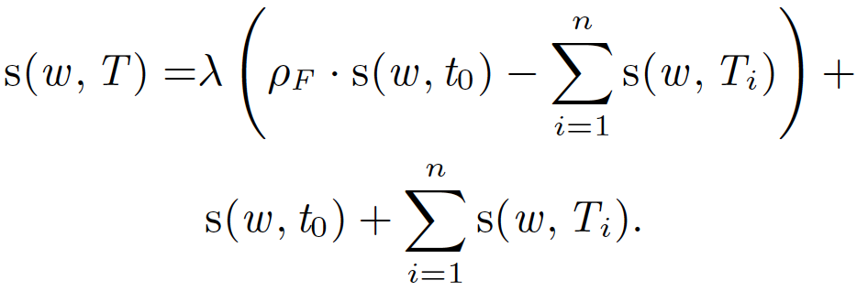
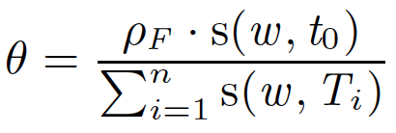

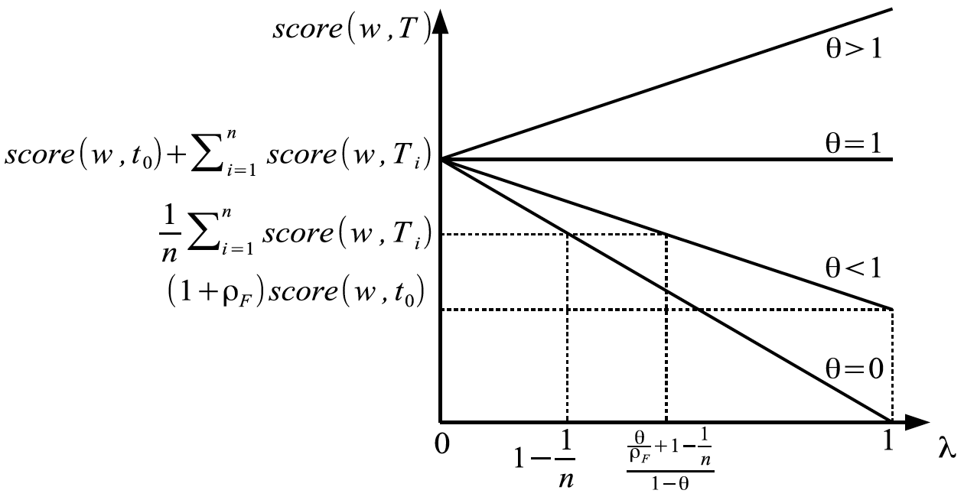
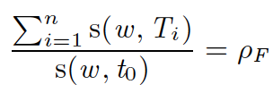

5. Structure-aware Combination
Properties of combHIS
  Is a term as representative as most other terms in the entity family?

Slide 17
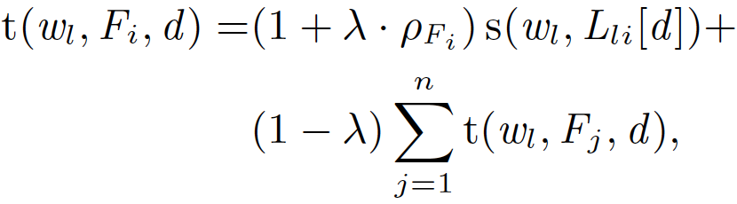
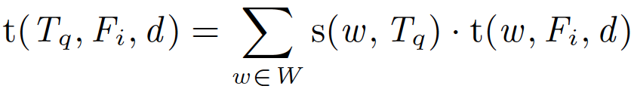
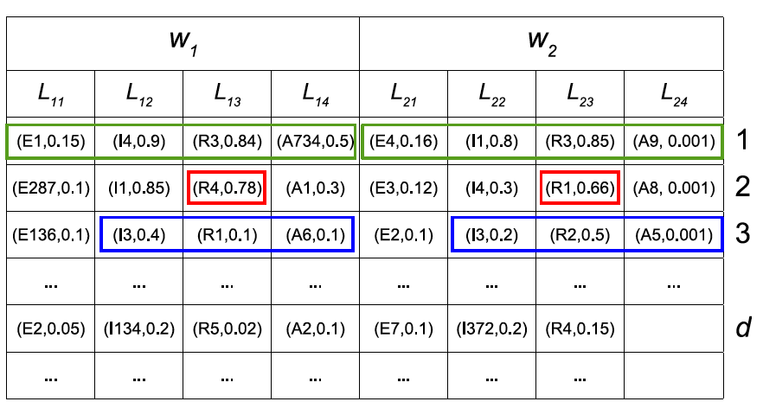
6. Efficient Entity Retrieval
Index
  an inverted index on terms over nodes
Threshold for Ranking

Slide 18
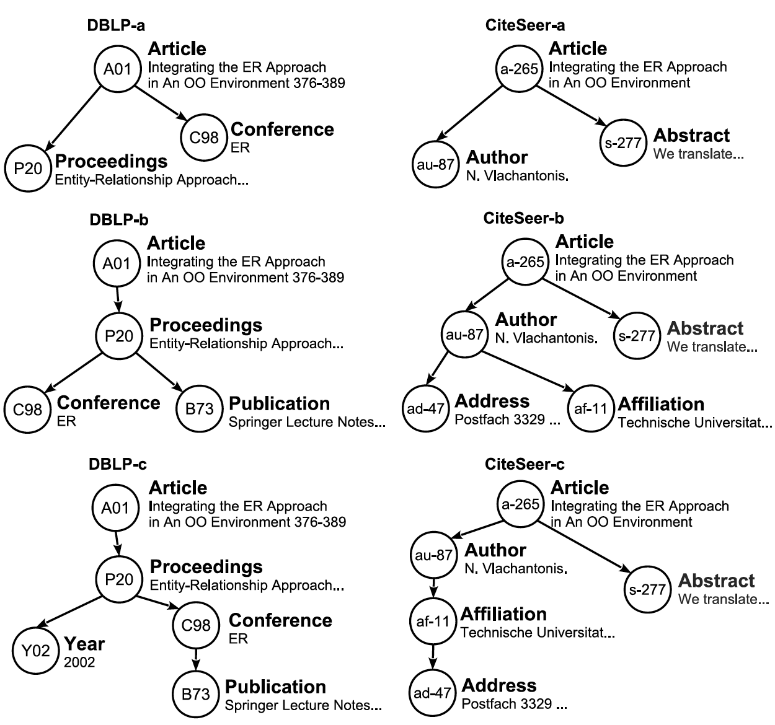
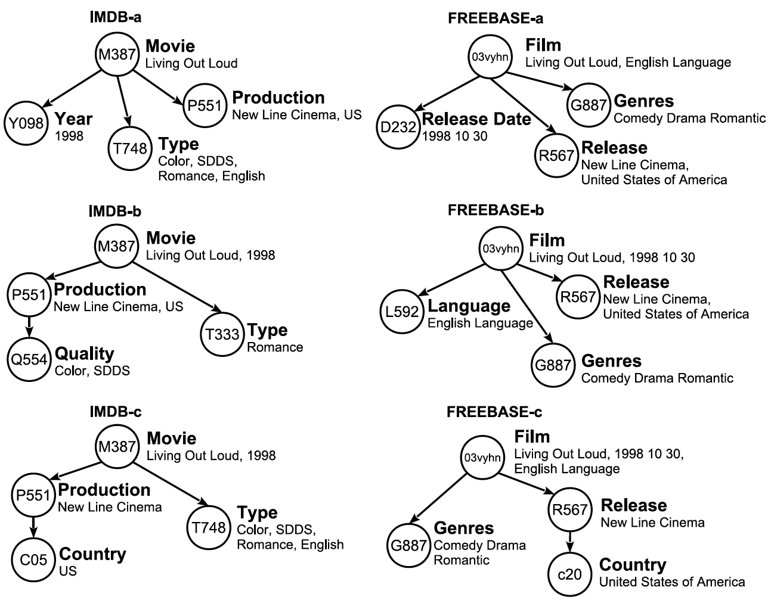
7. Experiments
Datasets
  Article & Movie

Slide 19
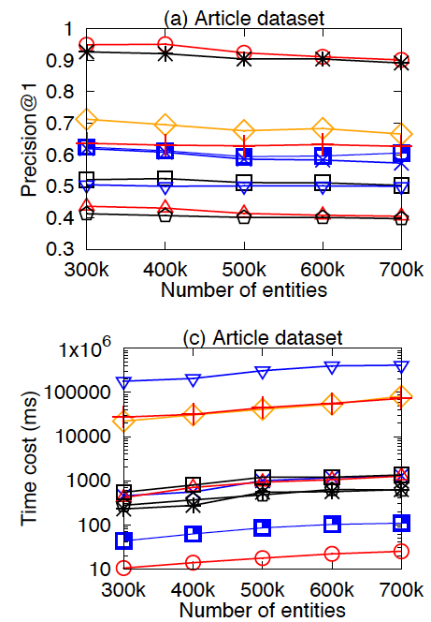
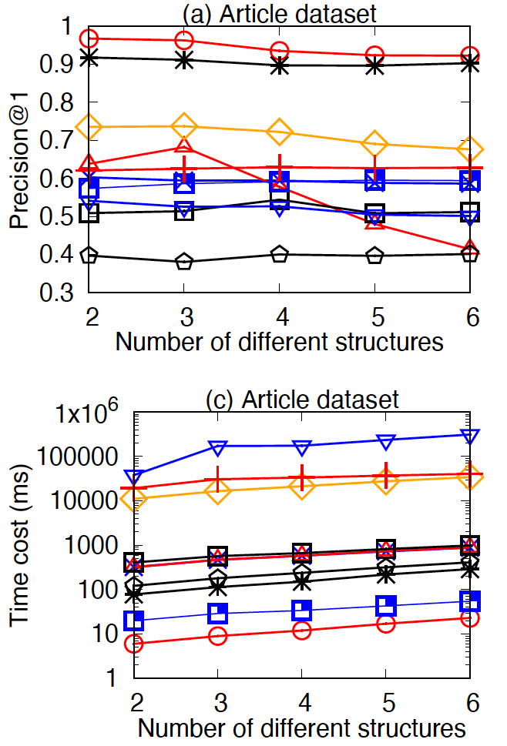
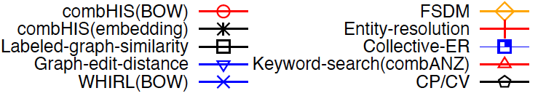
7. Experiments

Slide 20

Q & A

