Slide 1

Representing Temporal Attributes for Schema Matching
Yinan Mei¹, Shaoxu Song¹, Yunsu Lee², Jungho Park², Soo-Hyung Kim², Sungmin Yi²
¹BNRist, Tsinghua University, Beijing, China
²Samsung Research, Seoul, South Korea
KDD 2020

Slide 2
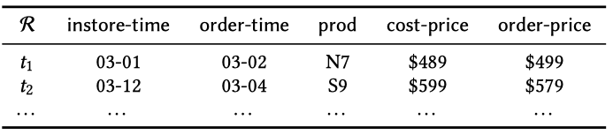
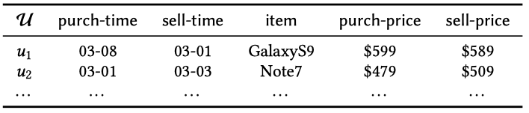
1. Background: Temporal Data
Temporal data are collected from heterogeneous data sources.
  order-price vs. sell-price
  order-time vs. sell-time
It‘s highly demanded to integrate the temporal data for various data mining tasks.
Business Decision
Accurate Model
Sufficient Data
KDD 2020

Slide 3
1. Background: Schema Matching
Schema matching is the process of identifying semantically related attributes.
Schema matching over temporal data
  Attribute matching
    order-price vs. sell-price
  Time attribute matching
    order-time vs. sell-time
KDD 2020

Slide 4
2. Challenge
Related attributes from different data sources are with confusing names and values.
  prod vs. item
Diﬀerent attributes may have highly similar timestamps and alike values.
  cost-price vs. sell-price
  purch-time vs. order-time
KDD 2020

Slide 5
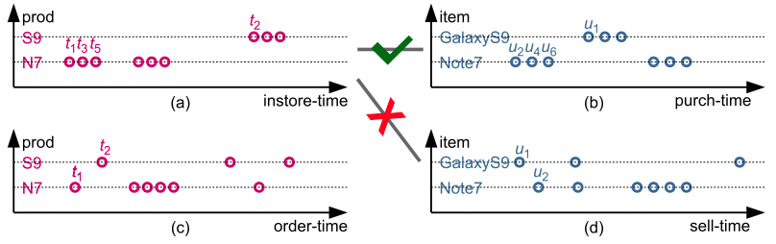
3. Motivation
Schema matching is enhanced by comparing the temporal features of temporal attribute pairs
  (instore-time, prod) vs. (purch-time, item)
KDD 2020

Slide 6
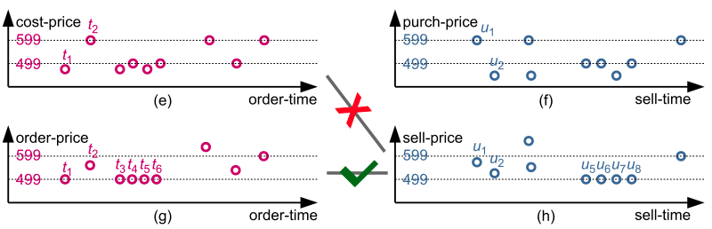
3. Motivation
Schema matching is enhanced by comparing the temporal features of temporal attribute pairs
  (order-time, order-price) vs. (sell-time, sell-price)
KDD 2020

Slide 7
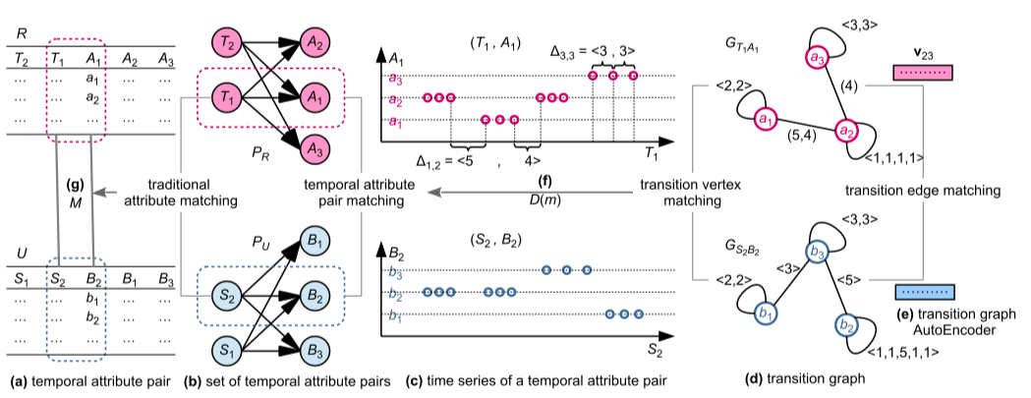
4. Our Proposal: TAM
Overview
KDD 2020

Slide 8
4. Our Proposal: TAM
Overview - Matching Temporal Attribute Pairs
KDD 2020

Slide 9
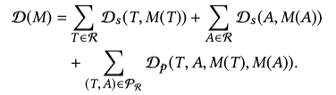
4. Our Proposal: TAM
Overview - Matching Temporal Attribute Pairs
Existing schema matching approaches
Our study
KDD 2020

Slide 10
4. Our Proposal: TAM
Overview - Matching Transition Graphs
KDD 2020

Slide 11


4. Our Proposal: TAM
Overview - Matching Transition Graphs
KDD 2020

Slide 12
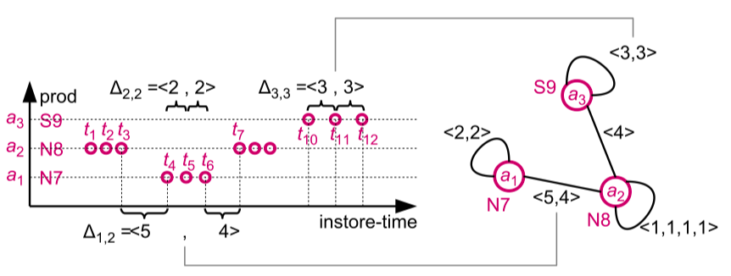
5. Representing Temporal Attribute
Transition Graph for Temporal Attribute
  Transitions contain the temporal information
Transitions
KDD 2020

Slide 13
5. Representing Temporal Attribute
Transition Graph for Temporal Attribute
Transitions
Transition Graph
KDD 2020

Slide 14
5. Representing Temporal Attribute
Unfortunately, directly evaluating the syntactic distance of transition graphs may not perform well.
Challenge – Vertices:
  Matched attribute values may have different representations
  N7 vs. Note7
(instore-time, prod)
(purch-time, item)
KDD 2020

Slide 15
5. Representing Temporal Attribute
Challenge – Vertices:
  Mismatched attribute values may have similar representations
  cost-price vs. sell-price
(instore-time, cost-price)
(purch-time, sell-price)
KDD 2020

Slide 16

5. Representing Temporal Attribute
Challenge – Edges:
  Matching edges with different lengths is difficult
  $\left(a_{2},a_{2}\right) vs. (b_{2},b_{2})$
KDD 2020

Slide 17
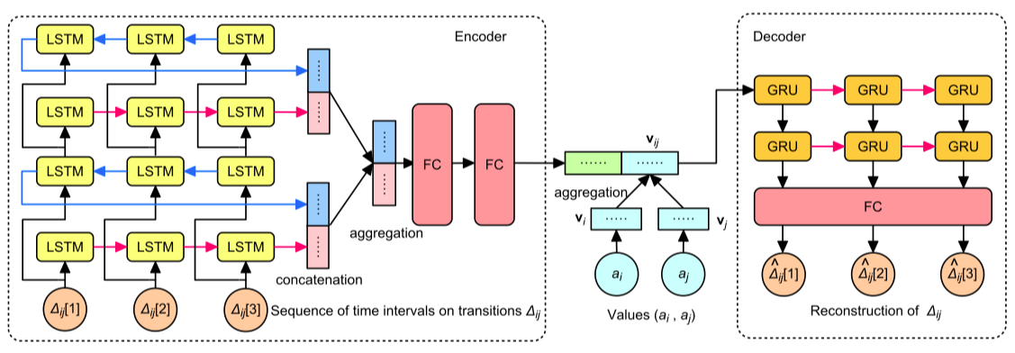
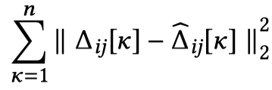
5. Representing Temporal Attribute
Transition Graph AutoEncoder
  Embed vertices and edges into a unified space
KDD 2020

Slide 18
6. Determining Matching Distance
Matching distance: Vertex Distance + Edge Distance
Theorem 1: Finding a mapping with minimum distance is NP-complete
Approximation: gradually improving the initial mapping (minimum vertex distance) in polynomial time.
······
······
······
······
······
······
KDD 2020

Slide 19
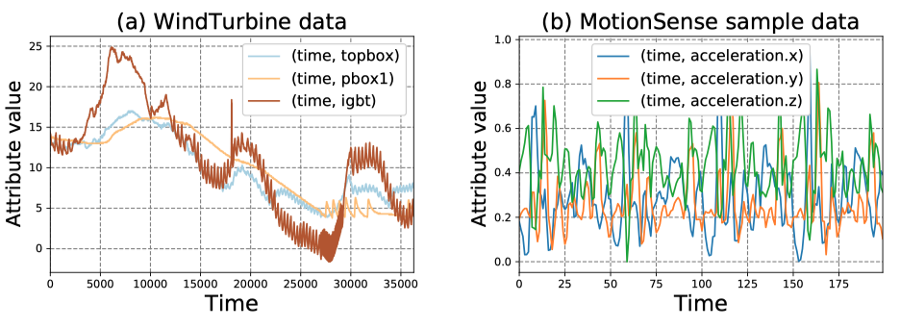
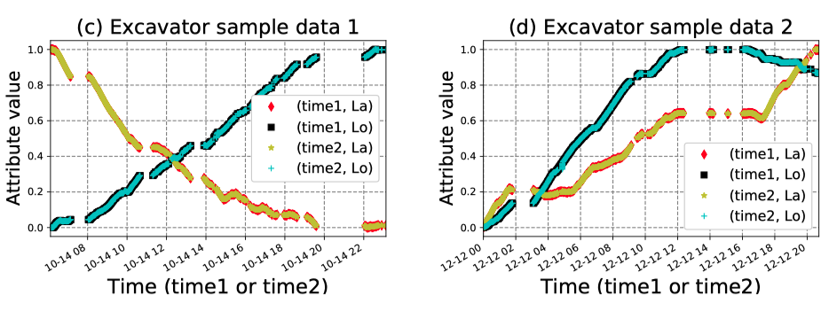

7. Experiments
KDD 2020

Slide 20
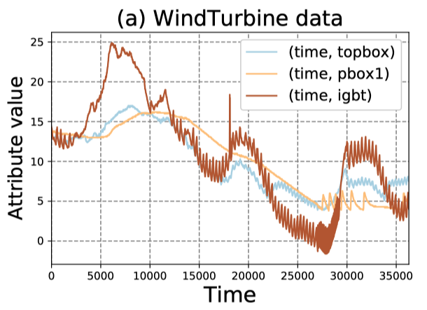
7. Experiments
WindTurbine Data
  Temperature data collected by different sensors of the wind turbine.
  Data storage protocols may change as devices are updated.
  “topbox”, “pbox1” in the new protocol
  “No.12” , “No.13” in the old protocol
KDD 2020

Slide 21
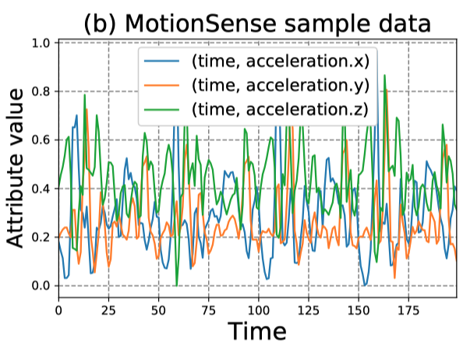
7. Experiments
MotionSense Data
  Data collected by accelerometer sensors.
  Sensors in phones from different manufacturers may name the data differently
  “Accleration.x” <-> “acc.x” <-> “acc.1”
KDD 2020

Slide 22
7. Experiments
Excavator Data
  Locations data from sensors of the excavators
  Data collected from various sources and stored in heterogeneous databases
  “time1” <-> “GEN_TIME” in data source 1
  “time1” <-> “receive-time” in data source 2
KDD 2020

Slide 23
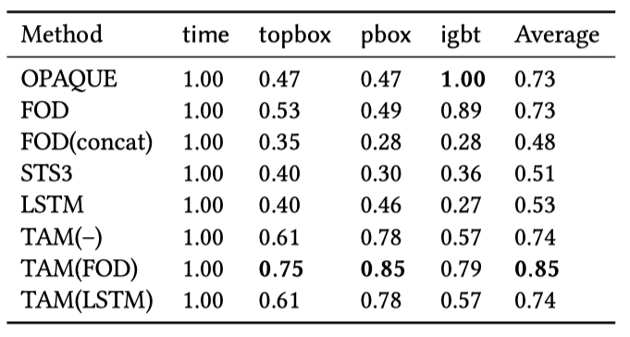
7. Experiments
Comparison with Existing Approaches
  igbt has a distribution diﬀerent from those of topbox & pbox1
    FOD [1] and Opaque [2] can distinguish it
  the time intervals of transitions in pbox1 are longer than those in topbox
[1] A . R. Jaiswal, D. J. Miller, and P. Mitra. Schema matching and embedded value mapping for databases with opaque column names and mixed continuous and discrete-valued data ﬁelds. ACM TODS, 38(1):2:1–2:34, 2013.
[2] Kang and J. F. Naughton. On schema matching with opaque column names and data values. In SIGMOD, pages 205–216. ACM, 2003.
KDD 2020

Slide 24
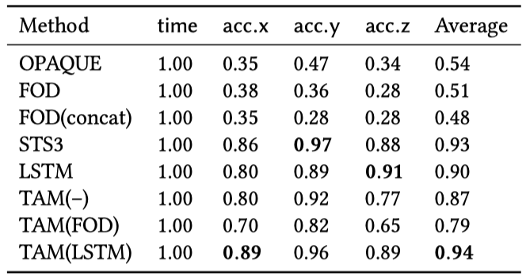
7. Experiments
Comparison with Existing Approaches
  Data collected with regular time intervals
  Similar distributions of values
  STS3 [3] and LSTM [4] can capture the temporal features.
[3J Peng, H. Wang, J. Li, and H. Gao. Set-based similarity search for time series. In SIGMOD, pages 2039–2052. ACM, 2016.
[4J S. Hochreiter and J. Schmidhuber. Long short-term memory. Neural Computation, 9(8):1735–1780, 1997.
KDD 2020

Slide 25
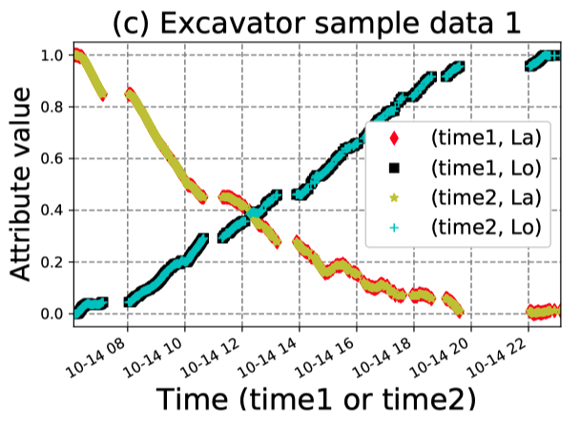
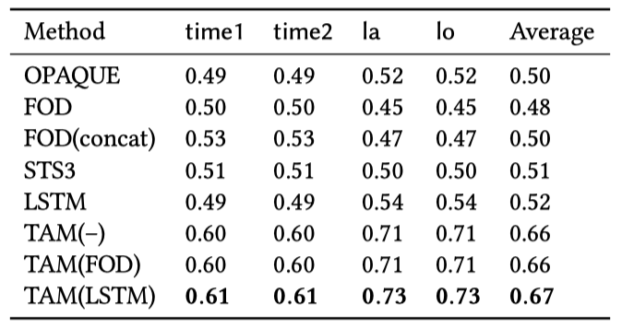
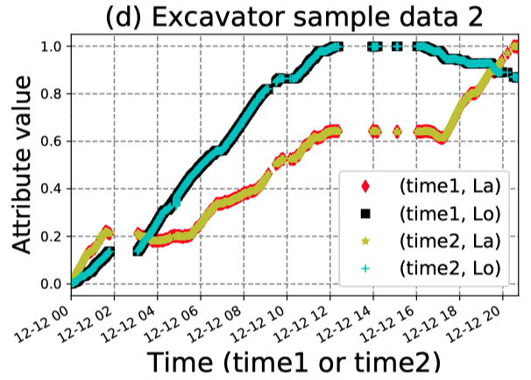
7. Experiments
Comparison with Existing Approaches
  Two time attributes
  Irregular time intervals
KDD 2020

Slide 26

Q & A
KDD 2020

