Slide 1
Matching Heterogeneous Events with Patterns
Xiaochen Zhu¹, Shaoxu Song¹, Jianmin Wang¹, Philip S. Yu², Jiaguang Sun¹
¹Tsinghua University, China
2University of Illinois at Chicago, USA
ICDE 2014

Slide 2
Outline
Motivation
Event Matching Framework
A* Search Algorithm
Computing the Normal Distance G
Simple Upper Bound of H
Advanced Bounding Function
Pay-As-You-Go Matching
Experiments
Conclusion
ICDE 2014

Slide 3
Information System and Event Log
Event ID | Trace ID | Event Name | Timestamp
1 | 1 | Order Received (A) | 04-22 13:33:34
2 | 1 | Payment (B) | 04-22 15:10:17
3 | 1 | Check Inventory (C) | 04-22 15:18:11
4 | 1 | Ship Goods (D) | 04-22 15:31:50
5 | 1 | Record Order (E) | 04-23 08:14:26
6 | 1 | Send Notification (F) | 04-23 08:17:18
Information systems play an important role in large enterprises:
Enterprise Resource Planning (ERP)
Office Automation (OA)
These systems record the business history in their event logs.
Trace ID | Trace | Trace ID | Trace
1 | A→B→C→D→E→F | 6 | A→C→B→D→E→F
2 | A→C→B→D→E→F | 7 | A→C→B→D→F→E
3 | A→C→B→D→F→E | 8 | A→C→B→D→F→E
4 | A→B→C→D→F→E | 9 | A→C→B→D→F→E
5 | A→C→B→D→E→F | 10 | A→C→B→D→F→E
A→B→C→D→E→F
ICDE 2014

Slide 4
Event Data Integration
Beijing Subsidiary
Shanghai Subsidiary
Guangzhou Subsidiary
Complex event processing
Provenance analysis
Decision support
Exploring the correspondence among events
Information systems
Information systems
Information systems
Event Logs
Event Logs
Event Logs
Business Data Warehouse
ICDE 2014

Slide 5
Heterogeneous Events
Different events may represent the same activity
Event Name | Timestamp
Order Received (A) | 04-22 13:33:34
Payment (B) | 04-22 15:10:17
Check Inventory (C) | 04-22 15:18:11
Ship Goods (D) | 04-22 15:31:50
Record Order (E) | 04-23 08:14:26
Send Notification (F) | 04-23 08:17:18
Event Name | Timestamp
JD (1) | 03-18 09:12:07
YD (2) | 03-18 09:27:14
TJD (3) | 03-18 09:30:18
CK (5) | 03-18 09:35:32
ZF (4) | 03-18 09:50:12
FH (6) | 03-18 10:30:47
DL (7) | 03-18 12:31:12
FT (8) | 03-18 12:40:40
English name
Abbreviation of Chinese phonetic representation
ICDE 2014

Slide 6
Convert Event Log to Graph
Text similarity fails → statistics and structural information
Event Log → Event Dependency Graph (V, E, f)
Trace ID | Trace
1 | A→B→C→D→E→F
2 | A→C→B→D→E→F
3 | A→C→B→D→F→E
4 | A→B→C→D→F→E
5 | A→C→B→D→E→F
6 | A→C→B→D→E→F
7 | A→C→B→D→F→E
8 | A→C→B→D→F→E
9 | A→C→B→D→F→E
10 | A→C→B→D→F→E
1.0
1.0
B
E
0.2
0.8
0.4
frequency of appearance
0.8
0.6
f(A,A)
=1.0
A
D
1.0
frequency of consecutive events
0.2
0.4
f(A,C)=0.8
0.2
0.6
C
F
1.0
1.0
ICDE 2014

Slide 7
Graph-Based Matching Framework
Event logs → dependency graphs
Event matching → vertex mapping (injective mapping $M$ : V₁ → V₂)
0.3
G₁
B
G₂
2
G₁
0.2
B
Event Log 1
A
1
1.0
A
0.1
C
3
0.8
C
G₁
G₂
0.8
B
2
A
1
0.5
G₂
0.3
C
3
2
Event Log 2
1.0
1
0.2
G₁
B
G₂
2
0.7
3
A
1
0.7
C
3
How to evaluate the best mapping?
ICDE 2014

Slide 8
Evaluation of Mapping
0.3
0.5
Feature space: Vertex+Edge
Vertex:
Edge:
Similarity of corresponding elements:
$$S\left({(v}_{1},v_{2})→(M\left(v_{1}\right),M(v_{2}))\right)=1−\frac{|f_{1}\left(v_{1},v_{2}\right)−f_{2}(M\left(v_{1}\right), M(v_{2}))|}{f_{1}\left(v_{1},v_{2}\right)+f_{2}(M\left(v_{1}\right), M(v_{2}))}$$
G₁
0.2
G₂
0.3
2
2
B
2
B
B
1.0
0.1
1.0
1
0.2
A
1
A
3
C
0.7
3
0.8
C
0.8
0.7
mapping $M_{1}$={A→1, B→2, C→3}
A, B, C
A→1, B→2, C→3
(A,B), (A,C), (C,B)
(A,B)→(1,2), (A,C)→(1,3), (C,B)→(2,3)
S(B→2) = $1−\frac{\left|0.3−0.5\right|}{0.3+0.5}=0.75$
S((A,C)→(1,3)) = $1−\frac{\left|0.8−0.7\right|}{0.8+0.7}=0.93$
ICDE 2014

Slide 9
Normal Distance
Normal Distance*:
$$D^{N}\left(M\right)=\sum_{v_{1},v_{2}∈V_{1}}{(1−\frac{|f_{1}\left(v_{1},v_{2}\right)−f_{2}(M\left(v_{1}\right), M(v_{2}))|}{f_{1}\left(v_{1},v_{2}\right)+f_{2}(M\left(v_{1}\right), M(v_{2}))})}$$
Summation of the similarities of corresponding elements.
Higher is better.
* J. Kang and J. F. Naughton. On schema matching with opaque column
names and data values. In SIGMOD Conference, pages 205–216, 2003.
ICDE 2014

Slide 10
Event Matching Problem
$M_{1}$={A→1, B→2, C→3}
$M_{2}$={A→3, B→2, C→1}
Problem: Given two event logs $L_{1}$ and $L_{2}$, the event matching problem is to find an event mapping $M$ that maximizes $D^{N}(M)$.
G₁
G₂
0.3
0.5
0.2
0.3
B
2
B
2
B
2
1.0
A
0.1
1.0
1
0.2
A
1
A
1
C
3
C
3
0.8
C
0.7
3
0.8
0.7
$$D^{N}\left(M_{1}\right)=1+\frac{3}{4}+\frac{14}{15}+\frac{4}{5}+\frac{14}{15}+\frac{2}{3}$$
$=5.08$
$$D^{N}\left(M_{2}\right)=\frac{14}{17}+\frac{3}{4}+\frac{1}{9}+1+\frac{1}{2}$$
$=3.18$
ICDE 2014

Slide 11
Vertex+Edge, Not Enough
1.0
1.0
$M_{best}$={A→6, B→2, C→1, D→3, E→4, F→5}
$M_{truth}$={A→3, B→4, C→5, D→6, E→7, F→8}
G₁
1.0
G₂
1.0
0.9
B
E
B
E
B
E
1
4
7
1
4
4
7
0.2
0.8
0.4
0.2
0.4
0.6
0.3
0.8
0.6
0.2
0.6
0.6
1.0
A
D
1.0
1.0
1.0
A
D
A
D
3
6
3
6
3
6
0.2
0.4
0.8
0.4
0.4
0.8
0.2
0.6
0.8
0.6
0.4
0.7
C
F
C
F
C
F
2
5
8
2
5
5
8
1.0
1.0
1.0
1.0
0.9
$D^{N}\left(M_{best}\right)=$14.00
$$D^{N}\left(M_{truth}\right)=13.91$$
Fail！
Vertex+Edge is not discriminative enough
ICDE 2014

Slide 12
More Feature: Event Patterns
Event Pattern: particular orders of event occurrence
Trace ID | Trace
1 | A→B→C→D→E→F
2 | A→C→B→D→E→F
3 | A→C→B→D→F→E
4 | A→B→C→D→F→E
5 | A→C→B→D→E→F
6 | A→C→B→D→E→F
7 | A→C→B→D→F→E
8 | A→C→B→D→F→E
9 | A→C→B→D→F→E
10 | A→C→B→D→F→E
match
${f(p}_{1})$=1.0
$p_{1}$=B
$p_{2}$=SEQ(D,E)
${f(p}_{2})$=0.4
$p_{3}$=AND(B,C)
${f(p}_{3})$=1.0
not match
$p_{4}$=SEQ(A,AND(B,C),D)
${f(p}_{4})$=1.0
ICDE 2014

Slide 13
Pattern Normal Distance
Given an event matching $M$ and a set of patterns $P$:
$$D^{N}\left(M\right)=\sum_{p ∈P}{(1−\frac{|f_{1}\left(p\right)−f_{2}(M\left(p\right))|}{f_{1}\left(p\right)+f_{2}(M\left(p\right))})}$$
Vertices and edges can also be seen as patterns.
Pattern Normal Distance is compatible with Normal Distance
ICDE 2014

Slide 14
Matching Events with Patterns
G₁
1.0
1.0
G₂
1.0
1.0
0.9
B
E
B
E
B
E
1
4
7
1
4
4
7
0.2
0.8
0.4
0.2
0.4
0.6
0.3
0.8
0.6
0.2
0.6
0.6
1.0
A
D
1.0
1.0
1.0
A
D
A
D
3
6
3
6
3
6
0.2
0.4
0.8
0.4
0.4
0.8
0.2
0.6
0.8
0.6
0.4
0.7
C
F
C
F
C
F
2
5
8
2
5
5
8
1.0
1.0
1.0
1.0
0.9
Patterns:
Vertex pattern: A, B, C, D, E, F
Edge pattern: SEQ(A,B), SEQ(A,C), SEQ(B,C), SEQ(C,B), SEQ(B,D), SEQ(C,D), SEQ(D,E), SEQ(D,F), SEQ(E,F), SEQ(F,E)
Complex pattern: SEQ(A, AND(B, C), D)
$M_{privous best}$={A→6, B→2, C→1, D→3, E→4, F→5}
$D^{N}\left(M_{privous best}\right)=$14.00
$M_{truth}$={A→3, B→4, C→5, D→6, E→7, F→8}
$$D^{N}\left(M_{truth}\right)=13.91$$
$$14.91$$
SEQ(A, AND(B, C), D) → SEQ(3, AND(4, 5), 6)
ICDE 2014

Slide 15
Hardness of Matching Events
Large amount of possible mappings:
A survey on a real Chinese bus manufacturer:
The average number of distinct events is 18;
The number of all the possible event mapping is $18!≈6.4×10^{15}$
Key issue is efficiency
ICDE 2014

Slide 16
Outline
Motivation
Event Matching Framework
A* Search Algorithm
Computing the Normal Distance G
Simple Upper Bound of H
Advanced Bounding Function
Pay-As-You-Go Matching
Experiments
Conclusion
ICDE 2014

Slide 17
A* Search Algorithm
Input: two dependency graphs, pre-defined patterns
Output: a vertex mapping with the maximum $D^{N}\left(M\right)$
Process: growth of an A* tree
Tree node:
Two Scores g and h:
g: current $D^{N}\left(M\right)$(exact)
h: remaining $D^{N}\left(M\right)$ (upper bound)
Heuristic: always visit the tree node with the highest g+h
$M$:{} $U_{1}$:{A,B,C,D} $U_{2}$:{1,2,3,4}
ICDE 2014

Slide 18
Growth of A* Search Tree
Root node
g: current $D^{N}\left(M\right)$(exact)
h: remaining $D^{N}\left(M\right)$ (upper bound)
$M$:{} $U_{1}$:{A,B,C,D} $U_{2}$:{1,2,3,4}
A
1,2,3,4
node 1
node 2
node 3
node 4
$M$:{A→1}
$U_{1}$:{B,C,D}
$U_{2}$:{2,3,4}
g: 0.8
h: 3.0
g+h: 3.8
$M$:{A→2}
$U_{1}$:{B,C,D}
$U_{2}$:{1,3,4}
g: 1.0
h: 3.0
g+h: 4.0
$M$:{A→3}
$U_{1}$:{B,C,D}
$U_{2}$:{1,2,4}
g: 0.7
h: 3.0
g+h: 3.7
$M$:{A→4}
$U_{1}$:{B,C,D}
$U_{2}$:{1,2,3}
g: 0.5
h: 3.0
g+h: 3.5
C
1,3,4
node 5
node 6
node 7
$M$:{A→2,C→1}
$U_{1}$:{B,D}
$U_{2}$:{3,4}
g: 1.8
h: 2.0
g+h: 3.8
$M$:{A→2,C→3}
$U_{1}$:{B,D}
$U_{2}$:{1,4}
g: 2.0
h: 2.0
g+h: 4.0
$M$:{A→2,C→4}
$U_{1}$:{B,D}
$U_{2}$:{1,3}
g: 1.2
h: 2.0
g+h: 3.2
node 10
$M$:{A→2,C→3,B→4,D→1}
$U_{1}$:{}
$U_{2}$:{}
Terminate when U₁ or U₂ is empty
g: 4.0
h: 0.0
g+h: 4.0
ICDE 2014

Slide 19
Incremental Computing of G
A
B
C
D
$M_{1}$:{A→1,B→2}
$U_{1}$:{C,D}
$U_{2}$:{3,4}
G₁
Patterns:
A, B, C, D,
SEQ(A,B), SEQ(B,C), SEQ(C,B), SEQ(C,D),
SEQ(A,B,C),
SEQ(B,C,D)
Parent node:
$$M_{1}$$
$$M_{2}$$
$M_{2}$:{A→1,B→2,C→3}
$U_{1}$:{D}
$U_{2}$:{4}
G₂
Child node:
1
2
3
4
1. newly introduced patterns:
3. compute similarities:
2. prune unmapped patterns:
, SEQ(C,B)
C, SEQ(B,C), SEQ(A,B,C)
, SEQ(C,B)
$g$ of the parent
+ these similarities
= $g$ of the child
3, SEQ(2,3), SEQ(1,2,3)
ICDE 2014

Slide 20
Estimating Upper Bound of H
Patterns:
A, B, C, D,
SEQ(A,B), SEQ(B,C), SEQ(C,B), SEQ(C,D),
SEQ(A,B,C), SEQ(B,C,D)
Remaining Patterns:
D,
SEQ(C,D),
SEQ(B,C,D)
Simple Bounding Function
We assume each remaining pattern has a matching pattern with similarity 1.0.
Let h = 3.
Advanced Bounding Function
$$S\left(p→M\left(p\right)\right)=1−\frac{|f_{1}\left(p\right)−f_{2}(M\left(p\right))|}{f_{1}\left(p\right)+f_{2}(M\left(p\right))}$$
Motivation: Estimation need speed.
Find $M\left(p\right)$ for each $p$ ?
Compute $f_{2}(M\left(p\right))$ online ?
G₁
A
B
C
D
$M_{2}$:{A→1,B→2,C→3}
$U_{1}$:{D}
$U_{2}$:{4}
G₂
1
2
3
4
ICDE 2014

Slide 21
Advanced Bounding Function
Use other frequency to take the place of$f_{2}(M(p))$
Highest vertex frequency $f_{n}$
Highest edge frequency $f_{e}$
Case of Pattern $p$ | Upper Bound
a general pattern | $$1−\frac{f_{1}\left(p\right)−f_{n}}{f_{1}\left(p\right)+f_{n}}$$
a simple pattern SEQ($v_{1}$, ... , $v_{k}$) | $$1−\frac{f_{1}\left(p\right)−f_{e}}{f_{1}\left(p\right)+f_{e}}$$
a simple pattern AND($v_{1}$, ... , $v_{k}$) | $$1−\frac{f_{1}\left(p\right)−{k!f}_{e}}{f_{1}\left(p\right)+{k!f}_{e}}$$
a complex pattern | $$1−\frac{f_{1}\left(p\right)−w(p)f_{n}}{f_{1}\left(p\right)+{w(p)f}_{n}}$$
ICDE 2014

Slide 22
Outline
Motivation
Event Matching Framework
A* Search Algorithm
Computing the Normal Distance G
Simple Upper Bound of H
Advanced Bounding Function
Pay-As-You-Go Matching
Experiments
Conclusion
ICDE 2014

Slide 23
Pay-As-You-Go Matching
Motivation:
Interesting event patterns are gradually identified.
Best matching may change.
Two heuristic strategy:
Continue
Restart
$M$:{} $U_{1}$:{A,B,C,D} $U_{2}$:{1,2,3,4}
$M$:{A→1}
$U_{1}$:{B,C,D}
$U_{2}$:{2,3,4}
$M$:{A→2}
$U_{1}$:{B,C,D}
$U_{2}$:{1,3,4}
$M$:{A→3}
$U_{1}$:{B,C,D}
$U_{2}$:{1,2,4}
$M$:{A→4}
$U_{1}$:{B,C,D}
$U_{2}$:{1,2,3}
$M$:{A→2,C→1}
$U_{1}$:{B,D}
$U_{2}$:{3,4}
$M$:{A→2,C→3}
$U_{1}$:{B,D}
$U_{2}$:{1,4}
$M$:{A→2,C→4}
$U_{1}$:{B,D}
$U_{2}$:{1,3}
Materialize leaf nodes
$M$:{A→2,C→3,B→4,D→1}
$U_{1}$:{}
$U_{2}$:{}
Materialize previous answer for pruning
ICDE 2014

Slide 24
Outline
Motivation
Event Matching Framework
A* Search Algorithm
Computing the Normal Distance G
Simple Upper Bound of H
Advanced Bounding Function
Pay-As-You-Go Matching
Experiments
Conclusion
ICDE 2014

Slide 25
Experiment Setting
Real Life Data Set: employed from the bus manufacturer
True-mapping is generated manually by domain experts.
Criteria: to evaluate the accuracy of event matching,
F-measure of precision and recall.
Baseline: Opaque matching¹, Iterative Matching².
1. J. Kang and J. F. Naughton. On schema matching with opaque column names and data values. In SIGMOD Conference, pages 205–216, 2003
2. S. Nejati, M. Sabetzadeh, M. Chechik, S. M. Easterbrook, and P. Zave. Matching and merging of statecharts specifications. In ICSE, pages 54–64, 2007.
No. of Event Logs | 38 | Min Event Size | 2
No. of Traces | 3000 | Max Event Size | 11
ICDE 2014

Slide 26
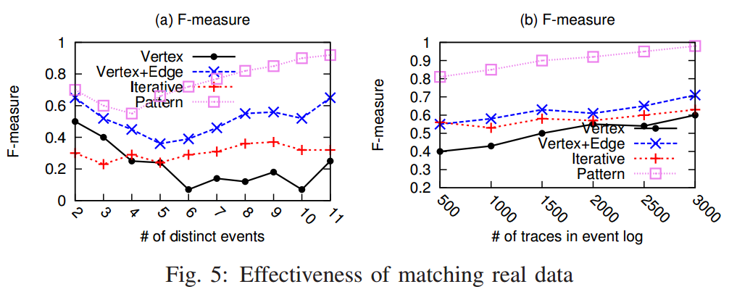
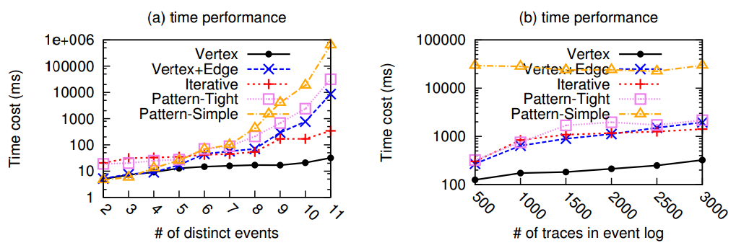
Effectiveness and Efficiency
Our Approach
Our Approach
Our Approach
Our Approach
ICDE 2014

Slide 27
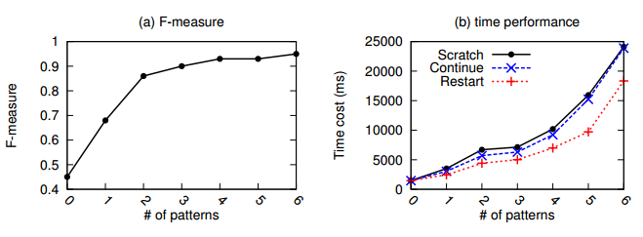
Performance on pay-as-you-go
More patterns, higher accuracy;
Pay-as-you-go strategies accelerate the re-computation of new event matching.
ICDE 2014

Slide 28
Conclusion
Pattern based generic framework
(Vertex+Edge+Complex) Patterns
Compatible with existing methods.
An advanced bounding function.
Support matching in a pay-as-you-go style.
ICDE 2014

Slide 29
Q & A
Thanks！
ICDE 2014

